Slide 1
CSC 112: Computer Operating Systems Lecture 2 Four Fundamental OS Concepts
Department of Computer Science,
Hofstra University
Acknowledgement: Lecture slides based on UC Berkeley CS 162: Operating Systems and System Programming

Slide 2
Today: Four Fundamental OS Concepts
Thread: Execution Context
Fully describes program state
Program Counter, Registers, Execution Flags, Stack
Address space (with or w/o translation)
Set of memory addresses accessible to program (for read or write)
May be distinct from memory space of the physical machine (in which case programs operate in a virtual address space)
Process: an instance of a running program
Protected Address Space + One or more Threads
Dual mode operation / Protection
Only the “system” has the ability to access certain resources
Combined with translation, isolates programs from each other and the OS from programs

Slide 3

OS Bottom Line: Run Programs
Executable
0xFFF…
Program Source
OS
int main()
{ … ;
}
compiler
data
Load & Execute
stack
editor
instructions
Memory
heap
foo.c
a.out
data
Write them and compile them
Load instruction and data segments of executable file into memory
Create stack and heap
“Transfer control to program”
Provide services to program
While protecting OS and program
instructions
0x000…
PC:
registers
Processor

Slide 4
Instruction Fetch/Decode/Execute
The instruction cycle
Memory
Processor
next
PC:
Instruction fetch
instruction
Decode
decode
Registers
Execute
ALU
data

Slide 5
What happens during program execution?
Addr 2³²-1
R0
…
R31
F0
…
F30
PC
…
Data1
Data0
Inst237
Inst236
…
Inst5
Inst4
Inst3
Inst2 Inst1
Inst0
Fetch
Exec
Execution sequence:
Fetch Instruction at PC
Decode
Execute (possibly using registers)
Write results to registers/mem
PC = Next Instruction(PC)
Repeat
PC
PC
PC
PC
Addr 0

Slide 6
First OS Concept: Thread of Control
Thread: Single unique execution context
Program Counter, Registers, Execution Flags, Stack, Memory State
A thread is executing on a processor (core) when it is resident in the processor registers
Resident means: Registers hold the root state (context) of the thread:
Including program counter (PC) register & currently executing instruction
PC points at next instruction in memory
Instructions stored in memory
Including intermediate values for ongoing computations
Can include actual values (like integers) or pointers to values in memory
Stack pointer holds the address of the top of stack (which is in memory)
The rest is “in memory”
A thread is suspended (not executing) when its state is not loaded (resident) into the processor
Notes:
Processor state pointing at some other thread
Program counter register is not pointing at next instruction from this thread
Often: a copy of the last value for each register stored in memory

Slide 7
Illusion of Multiple Processors
Assume a single processor (core). How do we provide the illusion of multiple processors?
Multiplex in time!
Threads are virtual cores
Contents of virtual core (thread):
Program counter, stack pointer
Registers
Where is “it” (the thread)?
On the real (physical) core, or
Saved in chunk of memory – called the Thread Control Block (TCB)
vCPU1
vCPU2
vCPU3
Shared Memory
vCPU1
vCPU2
vCPU3
vCPU1
vCPU2
Programmer’s View
Time

Slide 8
Illusion of Multiple Processors (Continued)
Consider:
At T1: vCPU1 on real core, vCPU2 in memory
At T2: vCPU2 on real core, vCPU1 in memory
What happened?
OS ran
Saved program counter (PC), stack pointer (SP), … in vCPU1’s TCB (in memory)
Loaded PC, SP, … from vCPU2's TCB, jumped to PC
What triggered this switch?
Timer, voluntary yield, I/O…
vCPU1
vCPU2
vCPU3
T1
T2
Shared Memory
vCPU1
vCPU2
vCPU3
vCPU1
vCPU2
Programmer’s View
Time

Slide 9
Multiprogramming - Multiple Threads of Control
Proc 1
Proc 2
Proc n
stack
…
heap
OS
Static Data
code
stack
Thread Control Block (TCB)
Holds contents of registers when thread not running
Where are TCBs stored?
In the kernel
heap
Static Data
code
stack
heap
Static Data
code
Notes:
What other information?

Slide 10
Second OS Concept: Address Space
Address space ⇒ the set of accessible addresses + state associated with them:
For 32-bit processor: 2³² = 4 billion (~10⁹) addresses
For 64-bit processor: 2⁶⁴ = 18 quintillion (~10¹⁸) addresses
What happens when you read or write to an address?
Perhaps acts like regular memory
Perhaps ignores writes
Perhaps causes I/O operation
(Memory-mapped I/O)
Perhaps causes exception (fault)
Communicates with another program
….
0xFFF…
stack
PC:
SP:
heap
Processor
registers
Static Data
instruction
Code Segment
0x000…

Slide 11
Previous discussion of threads: Very Simple Multiprogramming
All vCPU's share non-CPU resources
Memory, I/O Devices
Each thread can read/write memory
Perhaps data of others
can overwrite OS ?
This approach is used in
Very early days of computing
Embedded applications
MacOS 1-9/Windows 3.1 (switch only with voluntary yield)
Windows 95-ME (switch with yield or timer)
However it is risky…
vCPU1
vCPU2
vCPU3
vCPU1
vCPU2
Time

Slide 12
Simple Multiplexing has no Protection!
Operating System must protect itself from user programs
Reliability: compromising the operating system generally causes it to crash
Security: limit the scope of what threads can do
Privacy: limit each thread to the data it is permitted to access
Fairness: each thread should be limited to its appropriate share of system resources (CPU time, memory, I/O, etc)
OS must protect User programs from one another
Prevent threads owned by one user from impacting threads owned by another user
Example: prevent one user from stealing secret information from another user
Notes:
What can the hardware do to help the OS protect itself from programs???

Slide 13
Simple address translation with Base and Bound
0000…
code
0000…
code
Static Data
Addresses translated on-the-fly from range
[0000, 0100] to [1000, 1100]
heap
Static Data
heap
stack
0100…
stack
Base Address
1000…
code
1000…
0010…
Program
address
0010…
Static Data
1010…
heap
Bound
<
stack
1100…
0100…
Hardware relocation
FFFF…
Notes:
Can the program touch OS?
Can it touch other programs?

Slide 14
Virtual-to-Physical Address Space Translation
Program operates in a virtual address space that is distinct from the physical memory space of the machine
Break the entire virtual address space into equal size chunks (i.e., pages)
Hardware translates address using a page table
Special hardware register stores pointer to page table
Treat memory as page size frames and put any page into any frame …
“physical address”
0x000…
“virtual address”
Processor
translator
Memory
Registers
0xFFF…

Slide 15
Paged Virtual Address
Memory
Processor
Registers
<Page #>
Page Table
<Frame Addr>
instruction
<Page Offset>
Page (eg, 4 kb)
<Virtual Address> =
<Page #> <Page Offset>
PT Addr
Instructions operate on virtual addresses
Instruction address, load/store data address
Translated to a physical address through a Page Table by the hardware
Any Page of address space can be in any (page sized) frame in memory
Or not-present (access generates a page fault)
Notes:
Q: For a 64-bit address space and 16kb pages, which bits are used for indexing into the page table? Which for the page offset?
Q: How many page frames in 4 GB of memory? How many bits are needed for the Frame Address field?
Q: If the entire address space of a process is mapped and each entry is 32 bits in size (4 bytes), how large is the page table?
Q: In the above, how much of the memory would it occupy?
Q: Given how address space tends to be structured, how would you reduce the storage overhead of the page table?
Q: Assuming the address space is used sparsely, how else might you compress the size of the page table?
Q: If multiple instances of the same application are running, how could you reduce the memory footprint overall?
Q: What happens if a process has multiple threads?
Special register holds page table base address (of the process)

Slide 16
Third OS Concept: Process
Definition: execution environment with Restricted Rights
(Protected) Address Space with One or More Threads
Owns memory (address space)
Owns file descriptors, file system context, …
Encapsulate one or more threads sharing process resources
Application program executes as a process
Complex applications can fork/exec child processes
Why processes?
Protected from each other!
OS Protected from them
Processes provides memory protection
Fundamental tradeoff between protection and efficiency
Communication easier within a process
Communication harder between processes

Slide 17
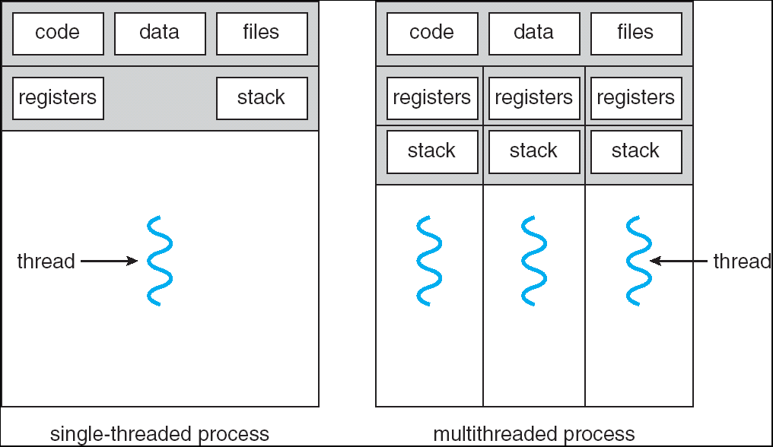
Single and Multithreaded Processes
Threads encapsulate concurrency:
“Active” component
Address spaces encapsulate protection:
“Passive” component
Keeps buggy programs from crashing the system
Why have multiple threads per address space?
Parallelism: take advantage of actual hardware parallelism (e.g. multicore)
Concurrency: ease of handling I/O and other simultaneous events
Notes:
Sometimes need parallelism for a single job, and processes are very expensive – to start, switch between, and to communicate between

Slide 18
Protection and Isolation
Why Do We Need Processes??
Reliability: bugs can only overwrite memory of process they are in
Security and privacy: malicious or compromised process can’t read or write other process’ data
Fairness: enforce shares of disk, CPU
Mechanisms:
Address translation: address space only contains its own data
BUT: why can’t a process change the page table pointer?
Or use I/O instructions to bypass the system?
Hardware must support privilege levels

Slide 19
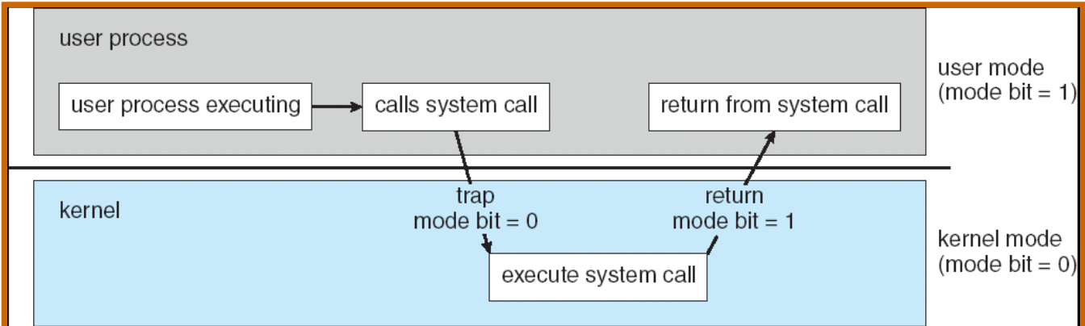
Fourth OS Concept: Dual Mode Operation
Hardware provides at least two modes (at least 1 mode bit):
Kernel Mode (or “supervisor” mode)
User Mode
Certain operations are prohibited when running in user mode
Changing the page table pointer, disabling interrupts, interacting directly w/ hardware, writing to kernel memory
Carefully controlled transitions between user mode and kernel mode
System calls, interrupts, exceptions

Slide 20
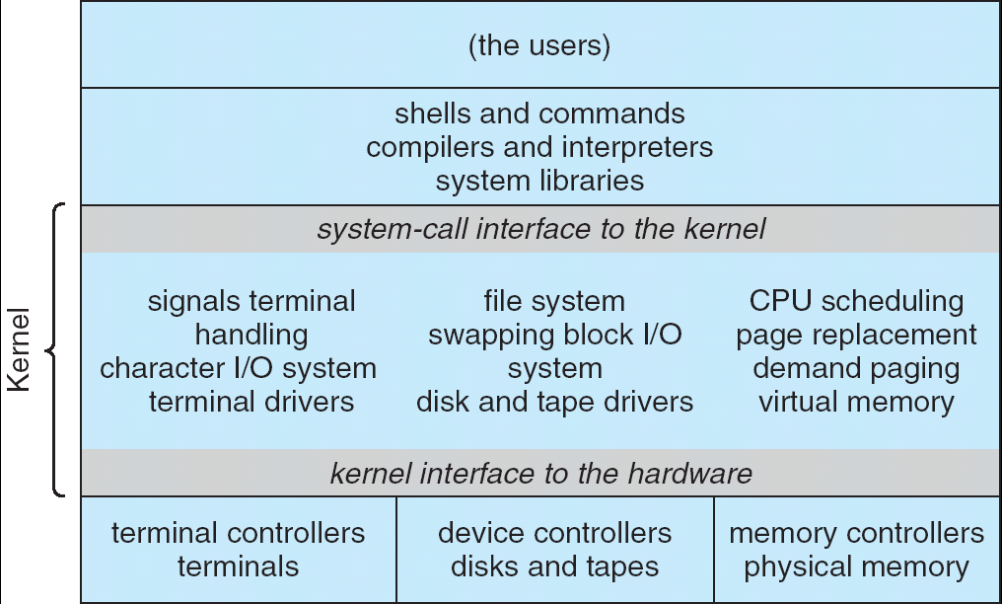
For example: UNIX System Structure
Applications
User Mode
Standard Libs
Kernel Mode
Hardware

Slide 21
User/Kernel (Privileged) Mode
User Mode
interrupt
exception
syscall
rtn
rfi
Kernel Mode
exit
exec
Limited HW access
Full HW access

Slide 22
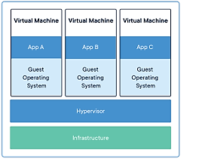
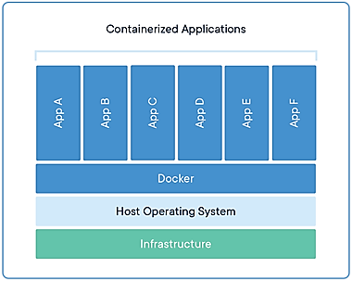
Additional Layers of Protection for Modern Systems
Additional layers of protection through virtual machines or containers
Run a complete operating system in a virtual machine
Package all the libraries associated with an app into a container for execution
More on these ideas later in the class

Slide 23
3 types of User ⇒ Kernel Mode Transfer
Syscall
Process requests a system service, e.g., exit
Put the syscall id and args in registers and exec syscall
Interrupt
External asynchronous event triggers context switch
e. g., Timer, I/O device
Independent of user process
Trap or Exception
Internal synchronous event in process triggers context switch
e.g., Protection violation (segmentation fault), Divide by zero, …
All 3 are an UNPROGRAMMED CONTROL TRANSFER
Where does it go?
Address of each interrupt handler
Interrupt
number (i)
intrpHandler_i () {
….
}
Interrupt Vector
Notes:
Like a function call, but “outside” the process
Does not have the address of the system function to call
Like a Remote Procedure Call (RPC) – for later

Slide 24
Running Many Programs ???
We have the basic mechanism to
switch between user processes and the kernel,
the kernel can switch among user processes,
Protect OS from user processes and processes from each other
Questions ???
How do we decide which user process to run?
How do we represent user processes in the OS?
How do we pack up the process and set it aside?
How do we get a stack and heap for the kernel?
…

Slide 25
Process Control Block and Scheduler
Kernel represents each process as a process control block (PCB)
Status (running, ready, blocked, …)
Register state (when not ready)
Process ID (PID), User, Executable, Priority, …
Execution time, …
Memory space, translation, …
Kernel Scheduler maintains a data structure containing the PCBs
Scheduling algorithm selects the next one to run
if ( readyProcesses(PCBs) ) {
nextPCB = selectProcess(PCBs);
run( nextPCB );
} else {
run_idle_process();
}

Slide 26
Conclusion: Four Fundamental OS Concepts
Thread: Execution Context
Fully describes program state
Program Counter, Registers, Execution Flags, Stack
Address space (with or w/o translation)
Set of memory addresses accessible to program (for read or write)
Virtual address space distinct from physical address space of the machine
Process: an instance of a running program
Protected Address Space + One or more Threads
Dual mode operation / Protection
Only the “system” has the ability to access certain resources
Combined with translation, isolates programs from each other and the OS from programs

